Slide 1
Lattice Boltzmann method
CDISE, PhD-2
Andrey Olhin

Slide 2
Outline
CFD. Relevance and applicability
Advantages of Lattice Boltzmann method
Lattice Boltzmann method in nutshell.
Discretization of equations. BGK model
Discretization of domain
Pros and Cons
What can we do with such a model?
Homework tips and algorithm

Slide 3
What is Fluid Flow?

Slide 4
What is Fluid Flow?
Fluid flows encountered in everyday life include:
meteorological phenomena (rain, wind, hurricanes, floods, fires)
environmental hazards (air pollution, transport of contaminants)
heating, ventilation and air conditioning of buildings, cars etc.
combustion in automobile engines and other propulsion systems
interaction of various objects with the surrounding air/water
complex flows in furnaces, heat exchangers, chemical reactors etc.
processes in human body (blood flow, breathing, drinking . . . )

Slide 5
What is CFD?

Slide 6
What is CFD?
Computational Fluid Dynamics (CFD) - provides a qualitative (and sometimes even quantitative) prediction of fluid flows.
mathematical modeling (partial differential equations)
numerical methods (discretization and solution techniques)
software tools (solvers, pre- and postprocessing utilities)
Lattice Boltzmann method!
CFD enables scientists and engineers to perform ‘numerical experiments’ (i.e. computer simulations) in a ‘virtual flow laboratory’

Slide 7
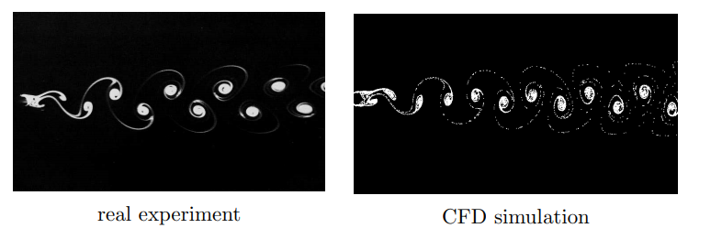
What is CFD?

Slide 8
Outline
CFD. Relevance and applicability
Advantages of Lattice Boltzmann method
Lattice Boltzmann method in nutshell.
Discretization of equations. BGK model
Discretization of domain
Pros and Cons
What can we do with such a model?
Homework tips and algorithm

Slide 9
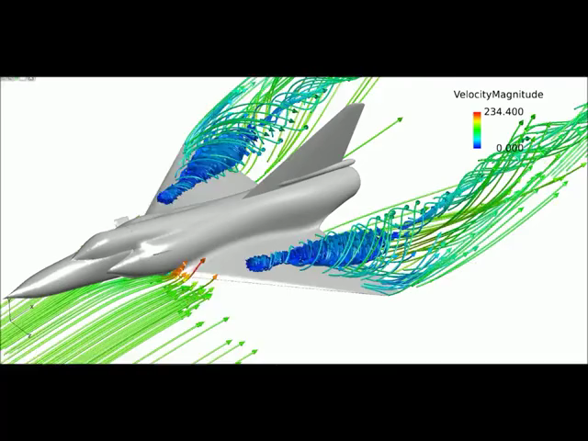
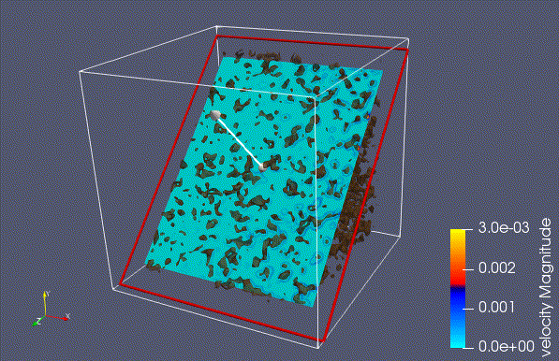
Size matters
Meters
Micro-nanometers (10^(-6)-10^(-9))

Slide 10
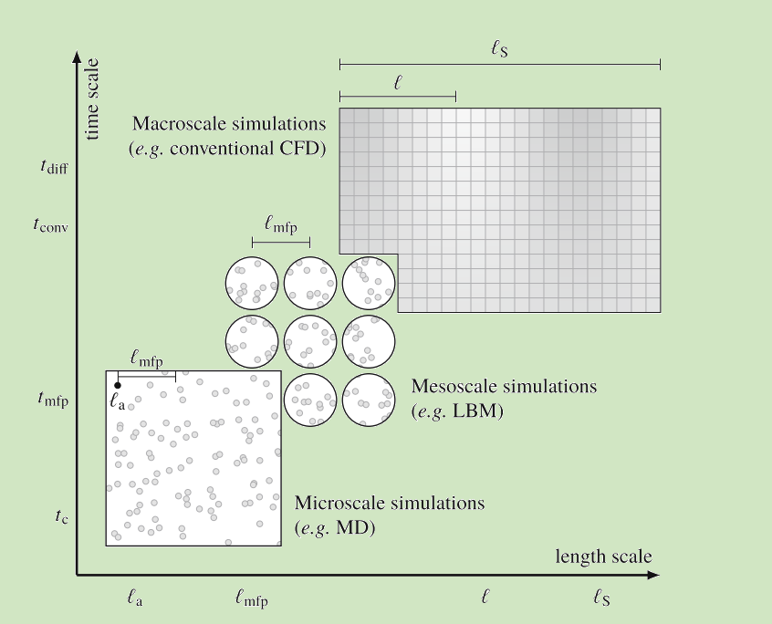
LBM’s place in the system
Notes:
Mean free path

Slide 11
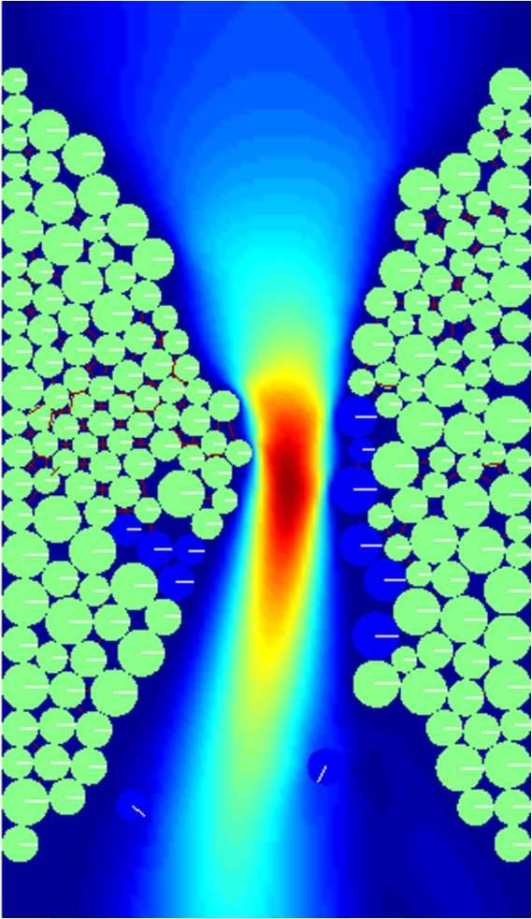
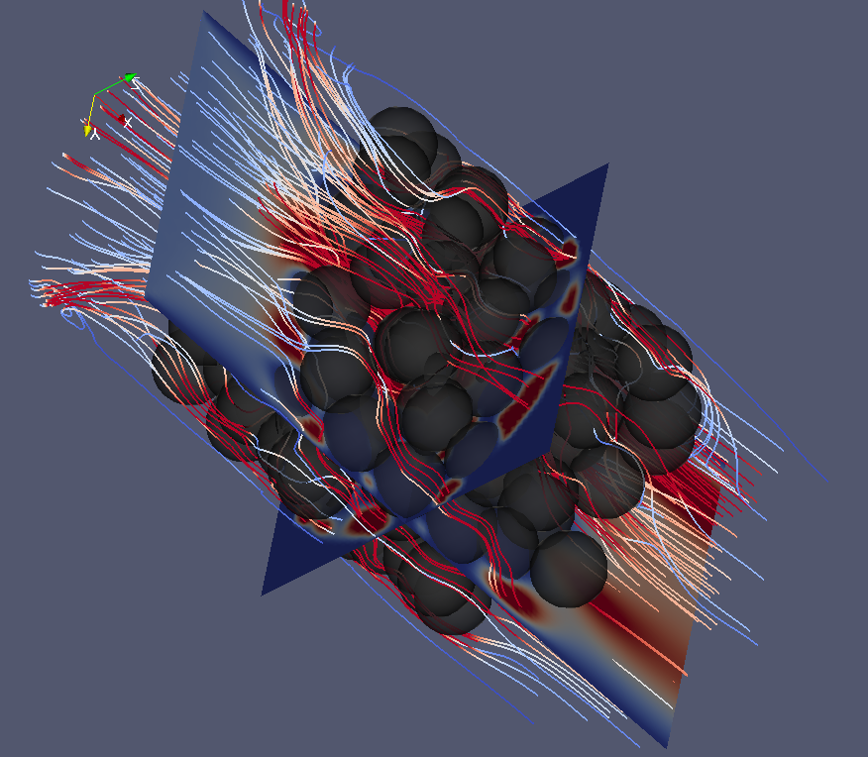
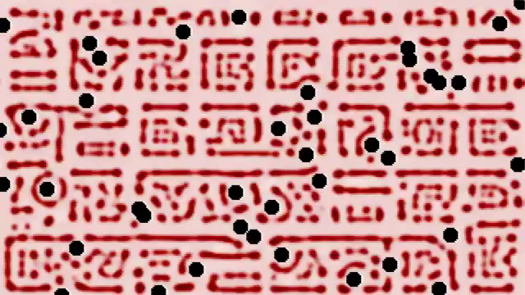
Examples

Slide 12
Outline
CFD. Relevance and applicability
Advantages of Lattice Boltzmann method
Lattice Boltzmann method in nutshell.
Discretization of equations. BGK model
Discretization of domain
Pros and Cons
What can we do with such a model?
Homework tips and algorithm

Slide 13
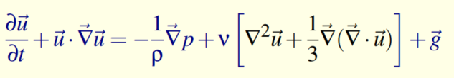
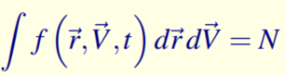
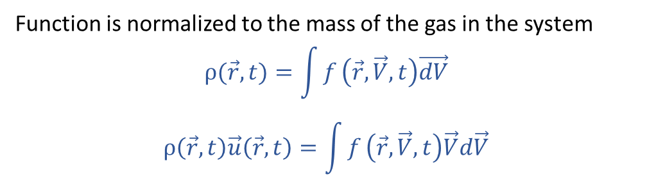
Lattice Boltzmann Method in nutshell
Navier-Stocks eq.
Boltzmann eq.
From the definition of VDF and its normalization:
Function is normalized to the mass of the gas in the system
$$ρ(\vec{r},t)=\int{f}\left(\vec{r},\vec{V},t\right)\vec{dV}$$
$$ρ\left(\vec{r},t\right)\vec{u}\left(\vec{r},t\right)=\int{f}\left(\vec{r},\vec{V},t\right)\vec{V}d\vec{V}$$
Macroscopic
Navier-Stocks eq.
!Only gases!
Mesoscopic
(Microscopic)
Boltzmann eq.
Lattice Boltzmann

Slide 14
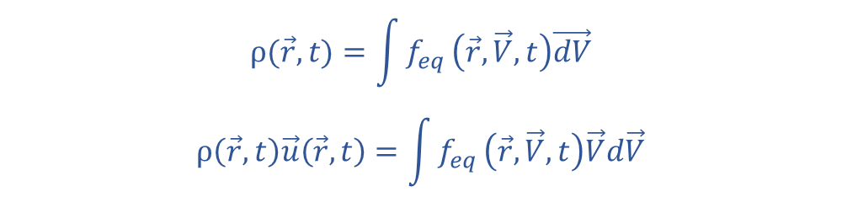
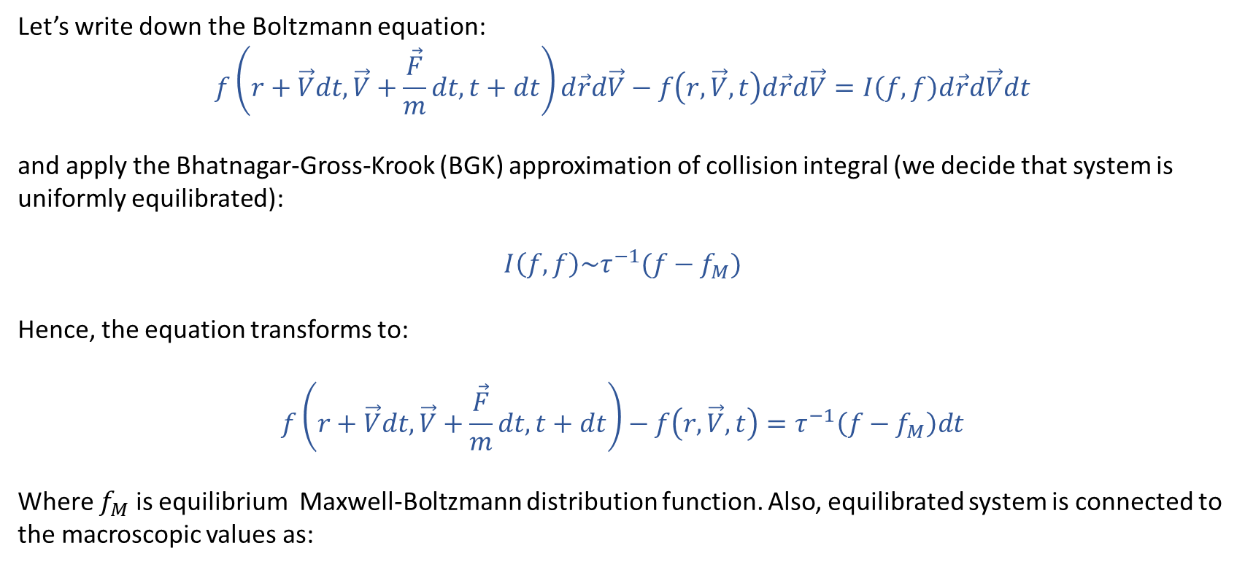

Lattice Boltzmann Method in Nutshell
Let’s write down the Boltzmann equation:
$$f\left(r+\vec{V}dt,\vec{V}+\frac{\vec{F}}{m}dt, t+dt\right)d\vec{r}d\vec{V}−f\left(r,\vec{V}, t\right)d\vec{r}d\vec{V}=I\left(f,f\right)d\vec{r}d\vec{V}dt$$
and apply the Bhatnagar-Gross-Krook (BGK) approximation of collision integral (we decide that system is uniformly equilibrated):
$$I\left(f,f\right)\sim τ^{−1}(f−f_{M})$$
Hence, the equation transforms to:
$$f\left(r+\vec{V}dt,\vec{V}+\frac{\vec{F}}{m}dt, t+dt\right)−f\left(r,\vec{V}, t\right)=τ^{−1}\left(f−f_{M}\right)dt$$
Where $f_{M}$ is equilibrium Maxwell-Boltzmann distribution function. Also, equilibrated system is connected to the macroscopic values as:
$$ρ(\vec{r},t)=\int{f_{eq}}\left(\vec{r},\vec{V},t\right)\vec{dV}$$
$$ρ\left(\vec{r},t\right)\vec{u}\left(\vec{r},t\right)=\int{f_{eq}}\left(\vec{r},\vec{V},t\right)\vec{V}d\vec{V}$$
$${f_{eq}=f}_{M}=\frac{ρ}{{\left(2πRT\right)}^{D/2}}e^{−\frac{{\left(\vec{V}−\vec{u}\right)}^{2}}{2RT}}$$

Slide 15
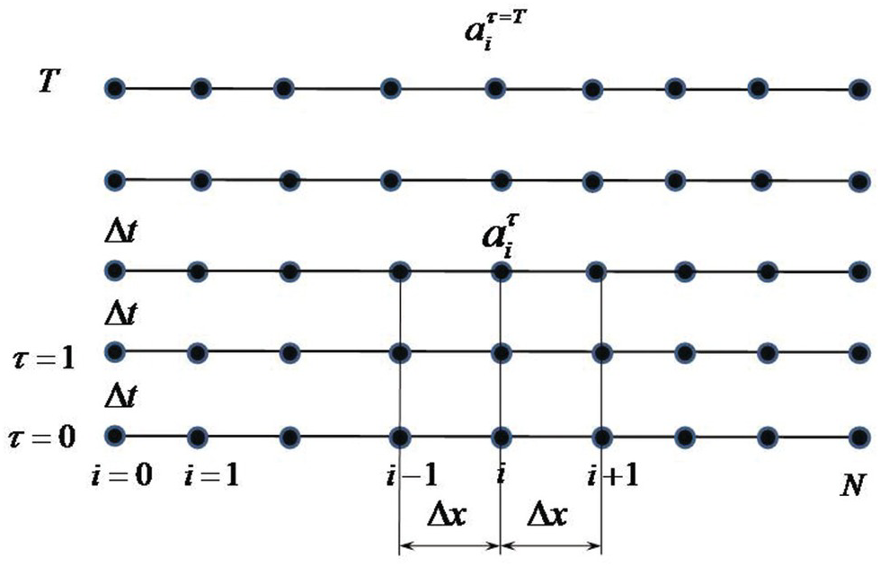
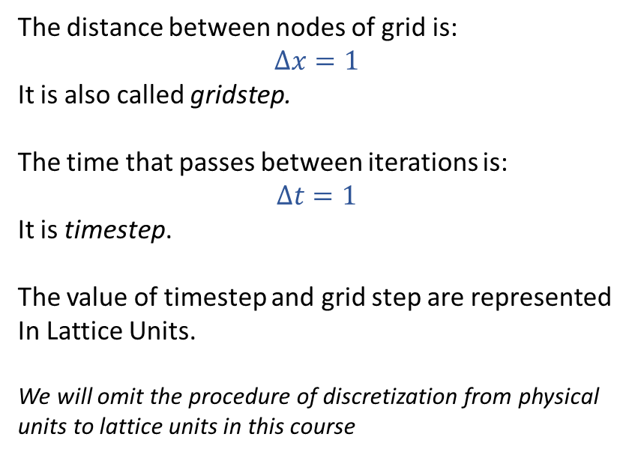
Discretization of domain
Lattice Boltzmann is the method of numerical modeling of fluid dynamics. So, numerical modeling involves performing the following steps:
Discretization of the domain.
Discretization of equations.
So, first let’s imply the simples 1D grid for example:
The distance between nodes of grid is:
$$Δx=1$$
It is also called gridstep.
The time that passes between iterations is:
$$Δt=1$$
It is timestep.
The value of timestep and grid step are represented
In Lattice Units.
We will omit the procedure of discretization from physical units to lattice units in this course

Slide 16
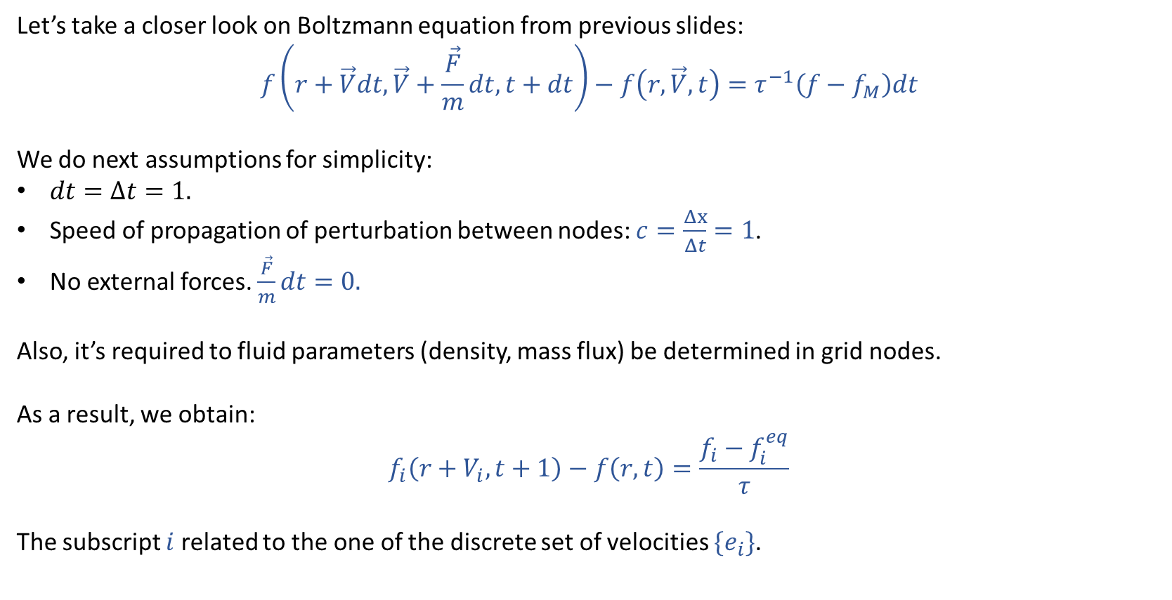
Discretization of equations. BGK model
Let’s take a closer look on Boltzmann equation from previous slides:
$$f\left(r+\vec{V}dt,\vec{V}+\frac{\vec{F}}{m}dt, t+dt\right)−f\left(r,\vec{V}, t\right)=τ^{−1}\left(f−f_{M}\right)dt$$
We do next assumptions for simplicity:
$dt=Δt=1.$
Speed of propagation of perturbation between nodes: $c=\frac{Δx}{Δt}=1$.
No external forces. $\frac{\vec{F}}{m}dt=0.$
Also, it’s required to fluid parameters (density, mass flux) be determined in grid nodes.
As a result, we obtain:
$$f_{i}\left(r+V_{i}, t+1\right)−f\left(r, t\right)=\frac{f_{i}−f_{i}^{eq}}{τ}$$
The subscript $i$ related to the one of the discrete set of velocities $\{e_{i}\}$.

Slide 17
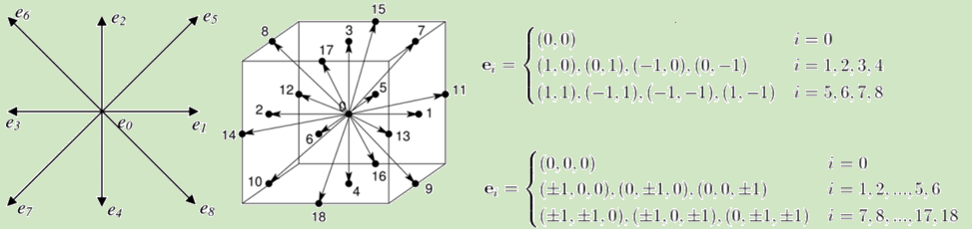
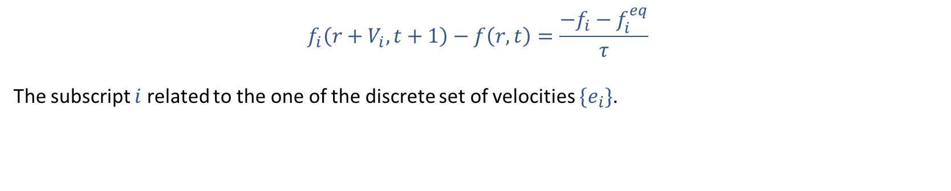
Discretization of equations. BGK model
$$f_{i}\left(r+V_{i}, t+1\right)−f\left(r, t\right)=\frac{−f_{i}−f_{i}^{eq}}{τ}$$
The subscript $i$ related to the one of the discrete set of velocities $\{e_{i}\}$.

Slide 18
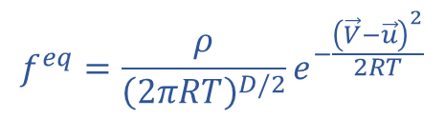
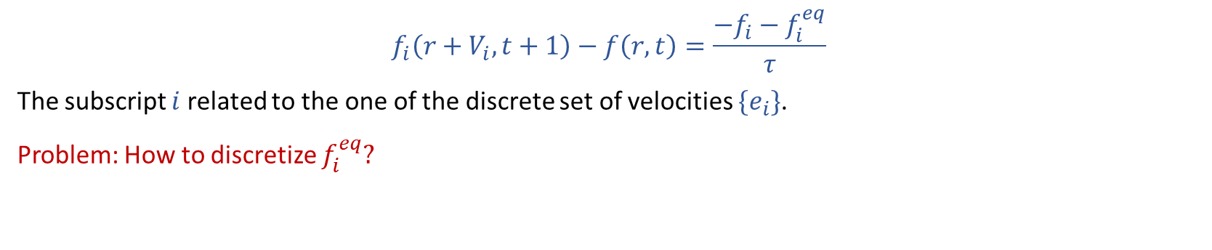
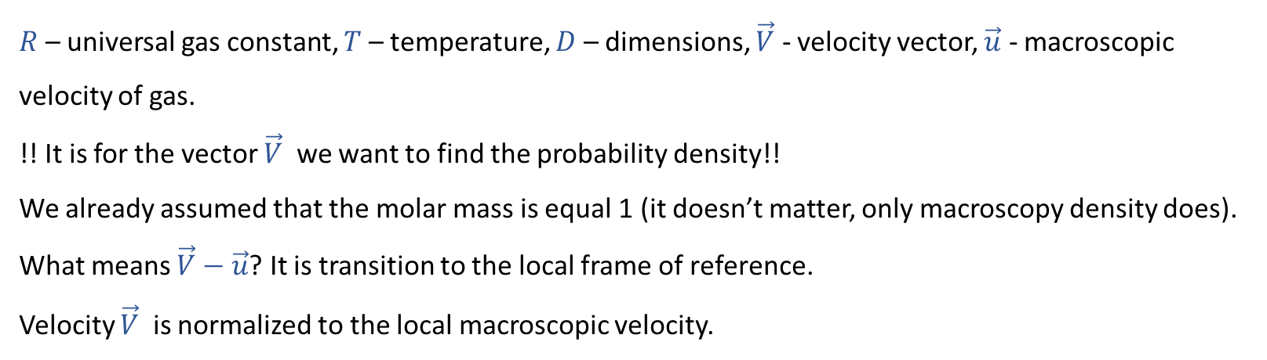
Discretization of equations. BGK model
$$f_{i}\left(r+V_{i}, t+1\right)−f\left(r, t\right)=\frac{−f_{i}−f_{i}^{eq}}{τ}$$
The subscript $i$ related to the one of the discrete set of velocities $\{e_{i}\}$.
Problem: How to discretize $f_{i}^{eq}?$
$$f^{eq}=\frac{ρ}{{\left(2πRT\right)}^{D/2}}e^{−\frac{{\left(\vec{V}−\vec{u}\right)}^{2}}{2RT}}$$
$R$ – universal gas constant, $T$ – temperature, $D$ – dimensions, $\vec{V}$ - velocity vector, $\vec{u}$ - macroscopic velocity of gas.
!! It is for the vector $\vec{V}$ we want to find the probability density!!
We already assumed that the molar mass is equal 1 (it doesn’t matter, only macroscopy density does).
What means $\vec{V}−\vec{u}$? It is transition to the local frame of reference.
Velocity $\vec{V}$ is normalized to the local macroscopic velocity.

Slide 19
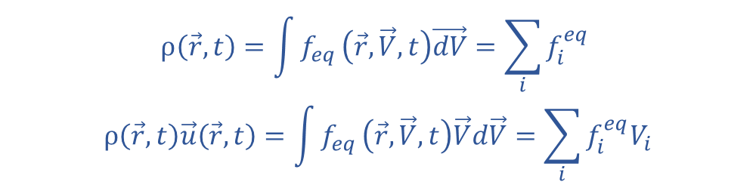
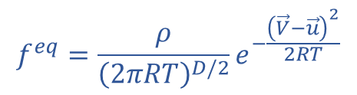
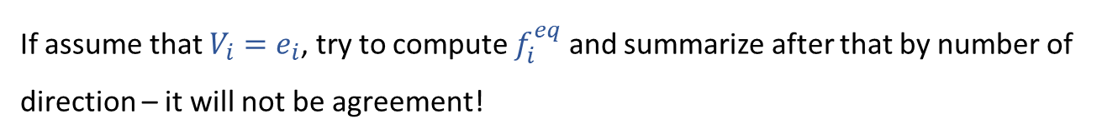
Discretization of equations. BGK model
$$f_{i}\left(r+v_{i}, t+1\right)−f\left(r, t\right)=\frac{−f_{i}−f_{i}^{eq}}{τ}$$
The subscript $i$ related to the one of the discrete set of velocities $\{e_{i}\}$.
Problem: How to discretize $f_{i}^{eq}?$
$$ρ\left(\vec{r},t\right)=\int{f_{eq}}\left(\vec{r},\vec{V},t\right)\vec{dV}=\sum_{i}{f_{i}^{eq}}$$
$$ρ\left(\vec{r},t\right)\vec{u}\left(\vec{r},t\right)=\int{f_{eq}}\left(\vec{r},\vec{V},t\right)\vec{V}d\vec{V}=\sum_{i}{f_{i}^{eq}V_{i}}$$
$$f^{eq}=\frac{ρ}{{\left(2πRT\right)}^{D/2}}e^{−\frac{{\left(\vec{V}−\vec{u}\right)}^{2}}{2RT}}$$
If assume that $V_{i}=e_{i}$, try to compute $f_{i}^{eq}$ and summarize after that by number of direction – it will not be agreement!

Slide 20
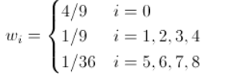
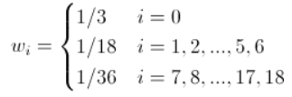
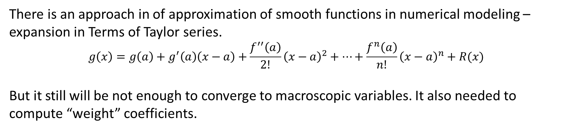

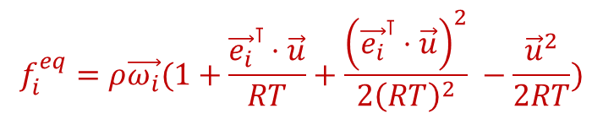
Discretization of equations. BGK model
There is an approach in of approximation of smooth functions in numerical modeling – expansion in Terms of Taylor series.
$$g\left(x\right)=g\left(a\right)+g^{′}\left(a\right)\left(x−a\right)+\frac{f^{′′}\left(a\right)}{2!}{\left(x−a\right)}^{2}+…+\frac{f^{n}\left(a\right)}{n!}{\left(x−a\right)}^{n}+R(x)$$
But it still will be not enough to converge to macroscopic variables. It also needed to compute “weight” coefficients.
$$f^{eq}=\frac{ρ}{{\left(2πRT\right)}^{D/2}}e^{−\frac{{\left(\vec{V}−\vec{u}\right)}^{2}}{2RT}}$$
$$f_{i}^{eq}=ρ\vec{ω_{i}}(1+\frac{{\vec{e_{i}}}^{⊺}⋅\vec{u}}{RT}+\frac{{\left({\vec{e_{i}}}^{⊺}⋅\vec{u}\right)}^{2}}{2{\left(RT\right)}^{2}} −\frac{{\vec{u}}^{2}}{2RT})$$
D2Q9
D3Q19
*Xiaoyi He and Li-Shi Luo (1997) Phys. Rev. E 56, 6811
https://journals.aps.org/pre/abstract/10.1103/PhysRevE.56.6811

Slide 21
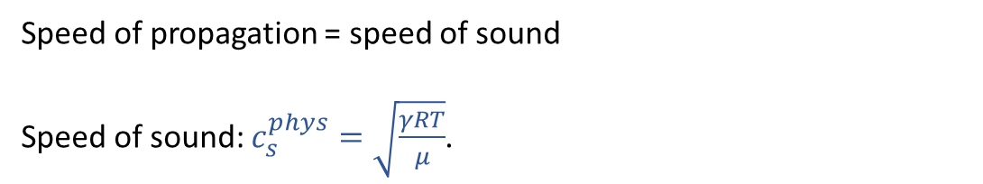
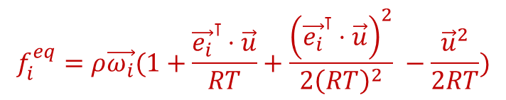

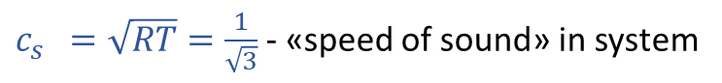
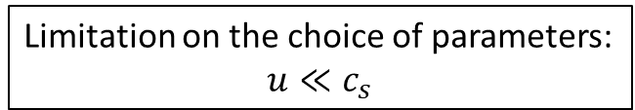
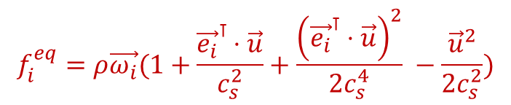
Discretization of equations. BGK model
Remark: R and T are not in SI.
Speed of propagation of perturbations between nodes: $c=\frac{Δx}{Δt}=1$.
$$f^{eq}=\frac{ρ}{{\left(2πRT\right)}^{D/2}}e^{−\frac{{\left(\vec{V}−\vec{u}\right)}^{2}}{2RT}}$$
Speed of propagation = speed of sound
Speed of sound: $c_{s}^{phys}=\sqrt{\frac{γRT}{μ}}$.
$$f_{i}^{eq}=ρ\vec{ω_{i}}(1+\frac{{\vec{e_{i}}}^{⊺}⋅\vec{u}}{RT}+\frac{{\left({\vec{e_{i}}}^{⊺}⋅\vec{u}\right)}^{2}}{2{\left(RT\right)}^{2}} −\frac{{\vec{u}}^{2}}{2RT})$$
$c_{s}^{}=\sqrt{RT}=\frac{1}{\sqrt{3}}$ - «speed of sound» in system
$$f_{i}^{eq}=ρ\vec{ω_{i}}(1+\frac{{\vec{e_{i}}}^{⊺}⋅\vec{u}}{c_{s}^{2}}+\frac{{\left({\vec{e_{i}}}^{⊺}⋅\vec{u}\right)}^{2}}{2c_{s}^{4}} −\frac{{\vec{u}}^{2}}{2c_{s}^{2}})$$
Limitation on the choice of parameters:
$$u≪c_{s}$$
D2Q9
D3Q19
*Xiaoyi He and Li-Shi Luo (1997) Phys. Rev. E 56, 6811
https://journals.aps.org/pre/abstract/10.1103/PhysRevE.56.6811

Slide 22
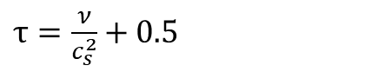
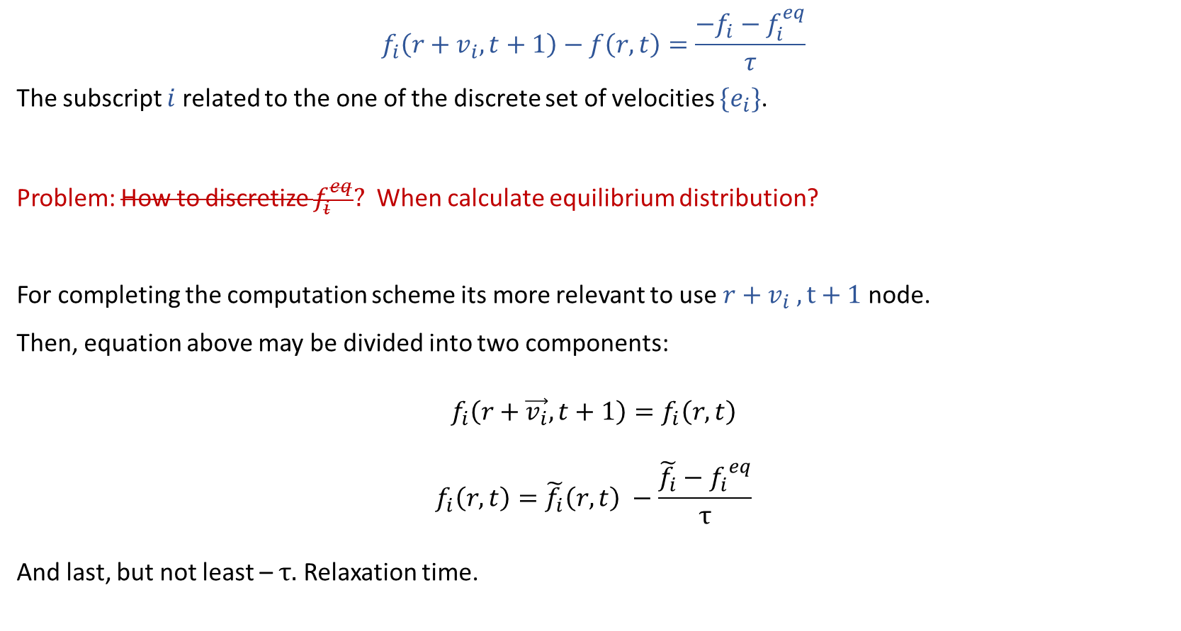
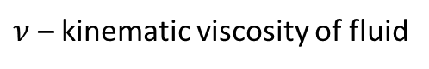
Discretization of equations. BGK model
$$f_{i}\left(r+v_{i}, t+1\right)−f\left(r, t\right)=\frac{−f_{i}−f_{i}^{eq}}{τ}$$
The subscript $i$ related to the one of the discrete set of velocities $\{e_{i}\}$.
Problem: How to discretize $f_{i}^{eq}?$ When calculate equilibrium distribution?
For completing the computation scheme its more relevant to use $r+v_{i} ,t+1$ node.
Then, equation above may be divided into two components:
$$f_{i}\left(r+\vec{v_{i}},t+1\right)=f_{i}\left(r,t\right)$$
$$f_{i}\left(r,t\right)=\tilde{f_{i}}\left(r,t\right) −\frac{\tilde{f_{i}}−{f_{i}}^{eq}}{τ}$$
And last, but not least – $τ.$ Relaxation time.
Streaming step
Collision step
$ν$ – kinematic viscosity of fluid
$τ=\frac{ν}{c_{s}^{2}}+0.5$

Slide 23
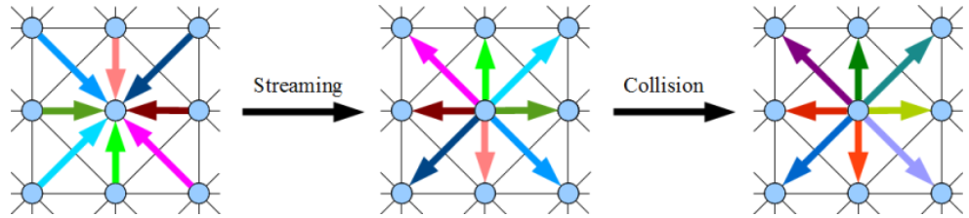


Lattice Boltzmann Method in Nutshell
For discretization of velocities directions mass and macroscopic velocity in every node will be equal to:
$$ρ=\sum_{i}{f_{i}}$$
$$ρu=\sum_{i}{f_{i}v_{i}}$$
$$f_{i}\left(r+\vec{v_{i}},t+1\right)=f_{i}\left(r,t\right)$$
$$f_{i}\left(r,t\right)=\tilde{f_{i}}\left(r,t\right) −\frac{\tilde{f_{i}}−{f_{i}}^{eq}}{τ}$$

Slide 24
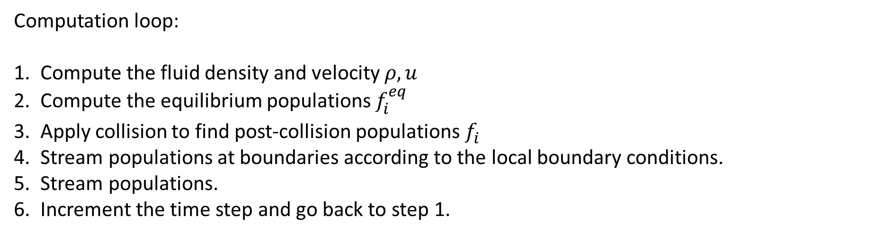
LBM Initialization and simulation
Initialization:
$$f_{i}^{eq}\left(x,t=0\right)=f_{i}^{eq}\left(ρ\left(x,t=0\right),u\left(x,t=0\right)\right)$$
Computation loop:
Compute the fluid density and velocity $ρ, u$
Compute the equilibrium populations $f_{i}^{eq}$
Apply collision to find post-collision populations $f_{i}^{}$
Stream populations at boundaries according to the local boundary conditions.
Stream populations.
Increment the time step and go back to step 1.

Slide 25
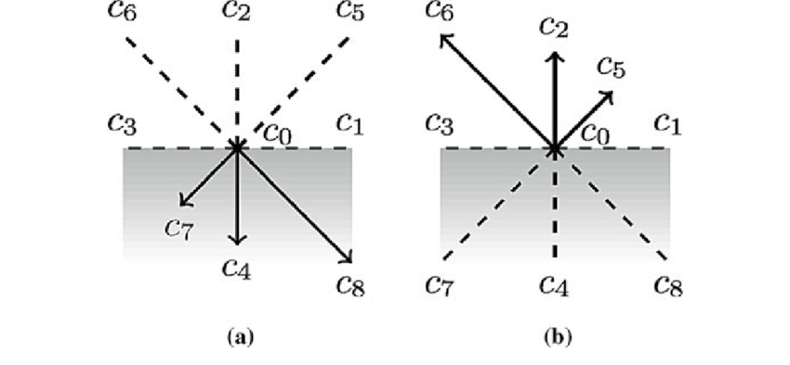
Boundary conditions in LBM
There are a great many variations of boundary conditions for Lattice Boltzmann method. I’ll show the simplest and most popular of them.
It is called “bounce-back” boundary condition. The physical meaning of this BC – no-slip for velocity.

Slide 26
Outline
CFD. Relevance and applicability
Advantages of Lattice Boltzmann method
Lattice Boltzmann method in nutshell.
Discretization of equations. BGK model
Discretization of domain
Pros and Cons
What can we do with such a model?
Homework tips and algorithm

Slide 27
Lattice Boltzmann Method pros and cons
Pros:
Simplicity and scalability
The computations are local, its easy to parallel
The LBM is well suited to simulating mass-conserving flows in complex geometries such as porous media
Moving boundaries that conserve mass can be implemented particularly well in the LBM making it an attractive method for soft matter simulations.
Wide range of multiphase and multicomponent methods available for the LBM.
Cons:
LBM is memory-intensive
Is not particularly efficient for simulating steady flows
Non-compressible flows
The LBM is not appropriate for directly simulating long-range propagation of sound at realistic viscosities

Slide 28
LBM Packages
Open source software:
Palabos
Open LB
WalLBerla
Ludwig
Commercial packages:
Dassault systems PowerFlow
ANSYS Discovery

Slide 29
Outline
CFD. Relevance and applicability
Advantages of Lattice Boltzmann method
Lattice Boltzmann method in nutshell.
Discretization of equations. BGK model
Discretization of domain
Pros and Cons
What can we do with such a model?
Homework tips and algorithm

Slide 30
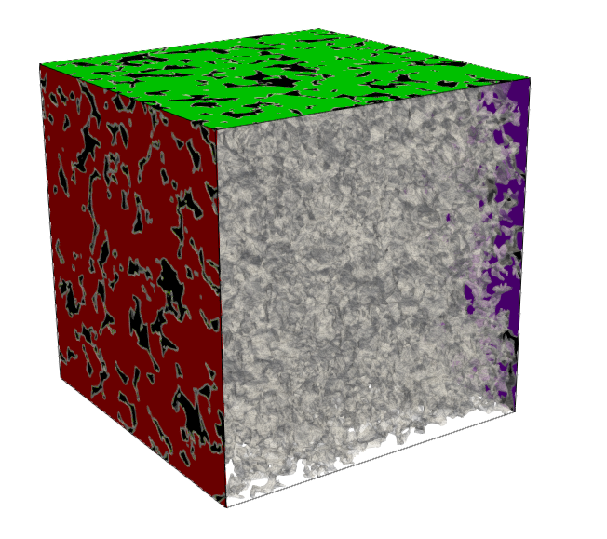
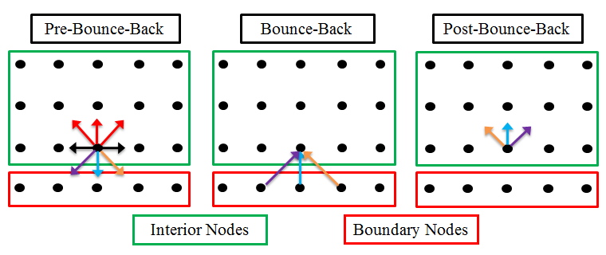
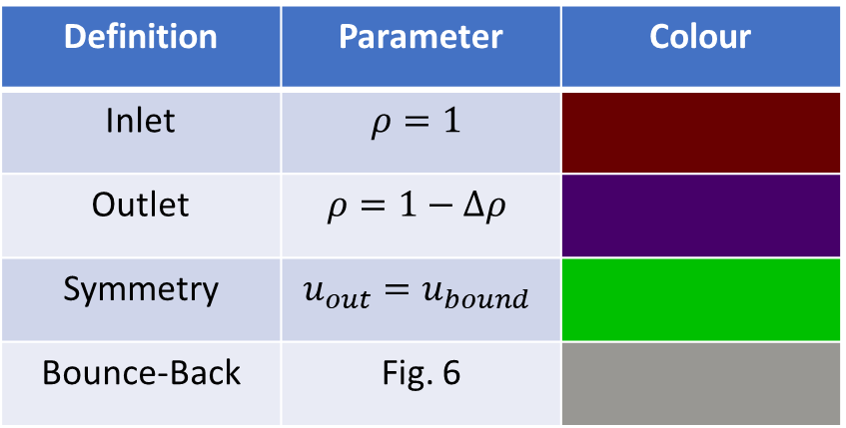
Permeability of rock samples
Definition | Parameter | Colour
Inlet | $$ρ=1$$
Outlet | $$ρ=1−Δρ$$
Symmetry | $$u_{out}=u_{bound}$$
Bounce-Back | Fig. 6
Porous media sample geometry with painted BCs
Bounce-Back BC scheme

Slide 31
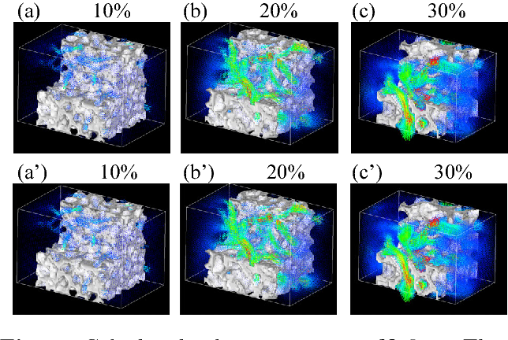
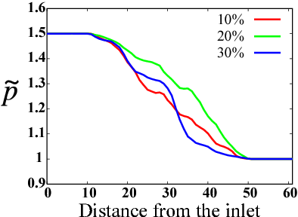
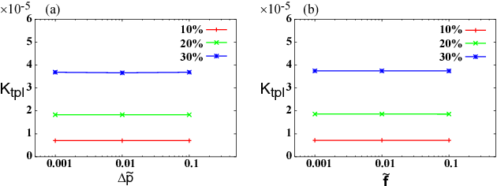
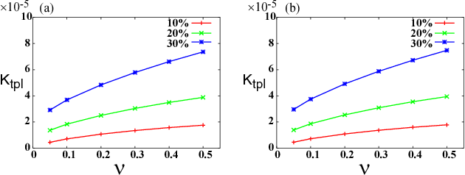
Permeability of rock samples
Up - Calculated pressure distribution averaged on the plane for three values of water content
Down – Dimensionless Permeability dependencies

Slide 32
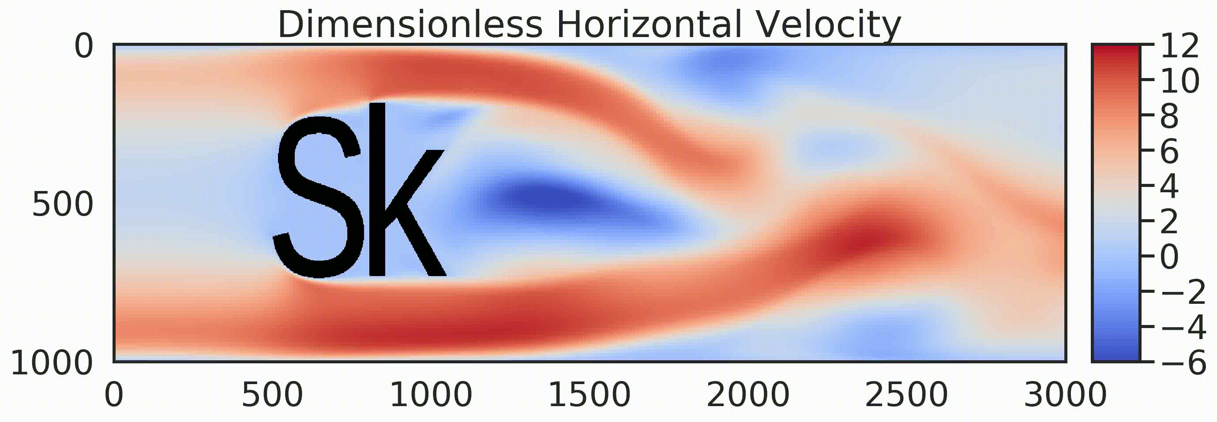
Overflow of different shapes

Slide 33
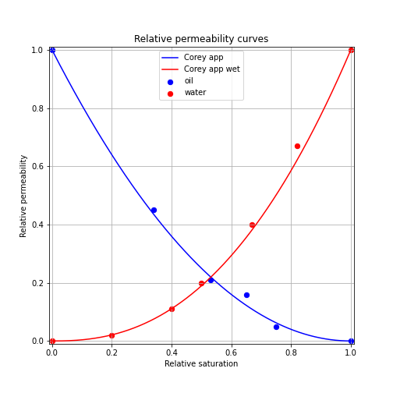
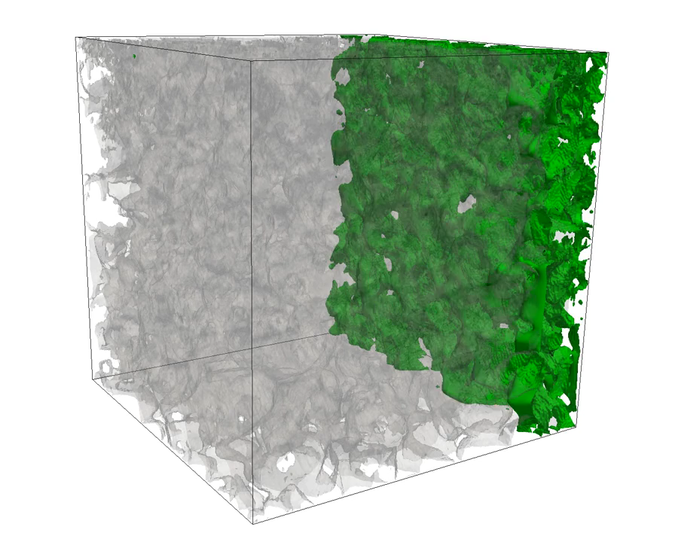

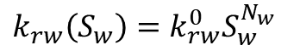
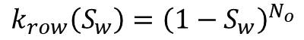
Multiphase flows
$$N_{o}=2$$
$$N_{w} ≈2.4$$
$$k_{row}\left(S_{w}\right)={\left(1−S_{w}\right)}^{N_{o}}$$
$$k_{rw}\left(S_{w}\right)=k_{rw}^{0}S_{w}^{N_{w}}$$

Slide 34
Outline
CFD. Relevance and applicability
Advantages of Lattice Boltzmann method
Lattice Boltzmann method in nutshell.
Discretization of equations. BGK model
Discretization of domain
Pros and Cons
What can we do with such a model?
Homework tips and algorithm

Slide 35


Homework tips
Sign | Description | Value
$$N_{x}$$ | Length of tube, equivalent to L | 100
$$N_{y}$$ | Diameter of tube, equivalent to 2*b | 20
$$ρ_{in}$$ | Inlet pressure in LBM units. | 1.5
$$ρ_{out}$$ | Outlet pressure in LBM units | 0.5
$$τ$$ | Relaxation time | ???
$$nt$$ | Number of time steps | ???

Slide 36




Homework tips
Poiseuille velocity profile:
$$u\left(y\right)=−\frac{Δp}{4ρνL}(R^{2}−y^{2})$$
$$\tilde{f_{i}}\left(r,t\right)=f_{i}\left(r+\vec{v_{i}},t+1\right)$$
$$f_{i}\left(r,t\right)=\tilde{f_{i}}\left(r,t\right) −\frac{\tilde{f_{i}}−{f_{i}}^{eq}}{τ}$$
Streaming step
Collision step
!Play with relaxation time!

Slide 37
Homework algorithm
*Initialize the domain* #(Q x Nx x Ny matrix)
*Initialize macroscopic fields*
*Initialize equilibrium at all nodes regarding to macroscopic field variables*
For timestep in simulation time:
*stream from boundary nodes* #counter clockwise starting from left boundary
*stream from corner nodes* #counter clockwise starting from top left corner
*stream on free nodes*
*collision on all nodes*
*Compute macroscopic variables by summation over the Q*
*Finish*

Slide 38
Thank You for attention!
Email: Andrey.Olhin@skoltech.ru
Telegram: @AndreyOlhin

